Slide 1
Code overview

Slide 2
@TissueParams
@SeqProtocol
@SPGR_Tissue
@???_Tissue
e.g. Yarnykh
@SPGR_Protocol
@???_Protocol
e.g. Yarnykh
@SeqJacobian
@SPGR_Jacobian
@???_Jacobian
e.g. Yarnykh
@SeqOptimization
@IterativeOptimization
@???Optimization
e.g. SimulateAnnealsing

Slide 3
@TissueParams
Public Properties | Public Methods
None | save(obj, fileName) load(obj, fileName) paramsArray = getParams(tissueKeys) paramValue = getParameter(paramKey)
@SPGR_Tissue
Public Properties | Public Methods
paramsKeys = {'F', 'kf', 'R1f', 'R1r', 'T2f', 'T2r'} fitParamsKeys = {'F', 'kf', 'R1f', 'T2f', 'T2r'} | SPGR_Tissue(paramsValues) paramsValues: Array of values for paramsKeys

Slide 4
@SeqProtocol
Public Properties | Public Methods
None | save(obj, fileName) load(obj, fileName) prot = getProtocol() **Abstract** totalNumOfMeas = getNumberOfMeas() paramValue = getParameter(protKey) remove(indices)
@SPGR_Protocol
Public Properties | Public Methods
fitProtKeys = {'B1_IR', 'B1_VFA'} B1_value = 1.0 | SPGR_Protocol(fileName) fileName: qMRLab saved protocol *.mat string totalNumOfMeas = getNumberOfMeas() paramValue = getParameter(protKey) remove(indices)

Slide 5
@SeqJacobian
Public Properties | Public Methods
None | SeqJacobian(@SeqProtocol, @TissueParams) jacobianMatrix = getJacobian() *jacobianStruct = getJacobianStruct() computeOpts = compute(computeOpts) computOpts: Struct with the following properties: mode: 'New', 'Resume', or 'Completed' paramsOfInterest: Cell array of strings of fitParamsKeys to calculate Jacobian. lineBuffer:
*jacobianStruct properties:
jacobianMatrix
paramsKeys
paramsVals
protocol
status
completedLines
signal
d_signal
@SPGR_Protocol
Public Properties | Public Methods
None | SPGR_Jacobian(@SPGR_Protocol, @SPGR_Tissue)

Slide 6
@SeqOptimization
Public Properties | Public Methods
None | *Static* paramError = minimizeParamErrorBecauseOfMeasError(paramJacMat, measJacMat, measError) fisherInformationMatrix = calcFIM(jacobianMatrix) crlb = calcCRLB(jacobianMatrix)
@IterativeOptimization
Public Properties | Public Methods
metricSet = {'CRLB'}; | IterativeOptimization(@SeqJacobian, opts) opts: Struct with the following properties: fitParams: Cell array of strings of fitParamsKeys to include in optimization (cols of Jac.) (optional) b1Params: Cell string of B1 params name for B1-sensitivity optimization) computeSingle(metricFlag) computeDoubleAlternate(metricFlags) computeRegularized(metricFlags, regularizationCoeff) rankedAcqPoints = getRankedAcqPoints() metricValsAcqPoints = getMetricValsAcqPoints() reguTermValsAcqPoints = getReguTermValsAcqPoints() [rankedAcqPoints_sorted, metricValsAcqPoints_sorted] = getSorted() [rankedAcqPoints_sorted, reguTermValsAcqPoints_sorted] = getSortedRegTerm() [rankedAcqPoints_sorted, protocol_sorted] = getSortedProtocol()

Slide 7
Theory Overview

Slide 8
MRM Paper theory

Slide 9
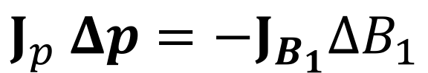
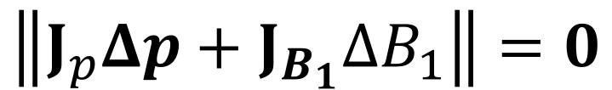
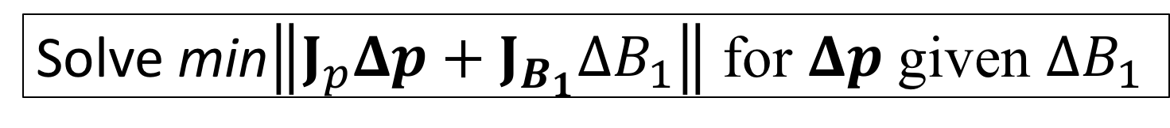
Updated approach
$$J_{p} Δp=−J_{B_{1}}ΔB_{1}$$
$$\left\|J_{p}Δp+J_{B_{1}}ΔB_{1}\right\|=0$$
Solve min$\left\|J_{p}Δp+J_{B_{1}}ΔB_{1}\right\|$ for $Δp$ given $ΔB_{1}$

Slide 10
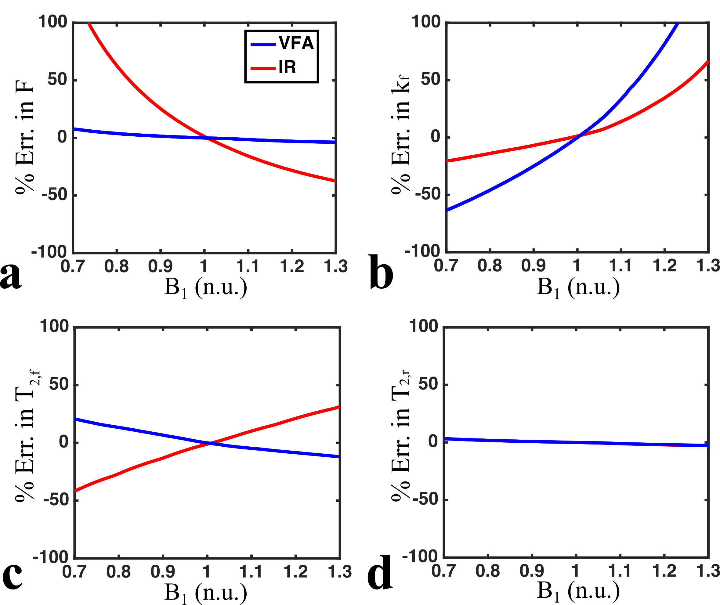
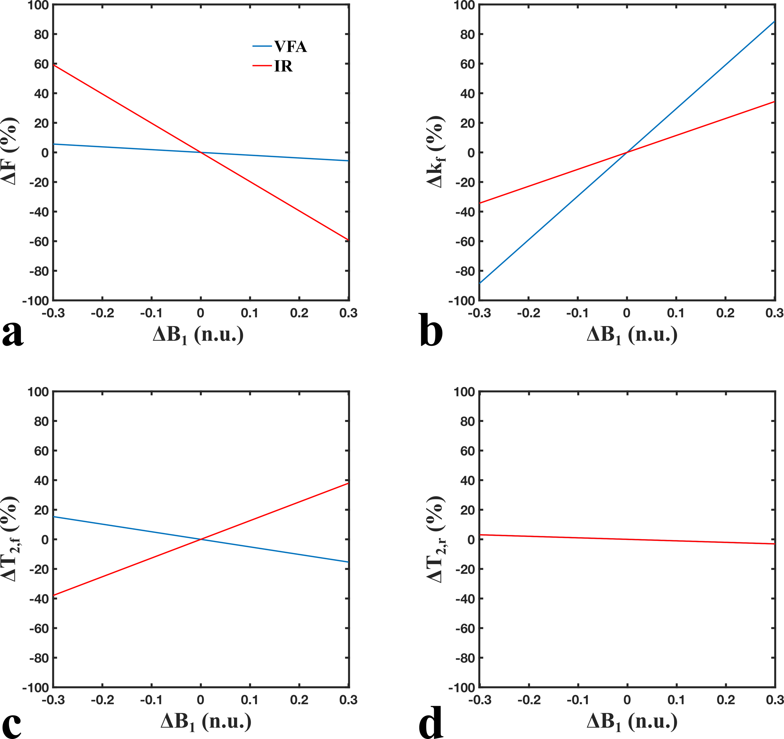
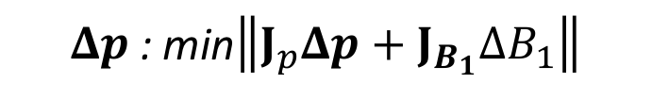
Parameter fitting error in simulations
$Δp$: min$\left\|J_{p}Δp+J_{B_{1}}ΔB_{1}\right\|$
MRM Paper
Current Work

Slide 11
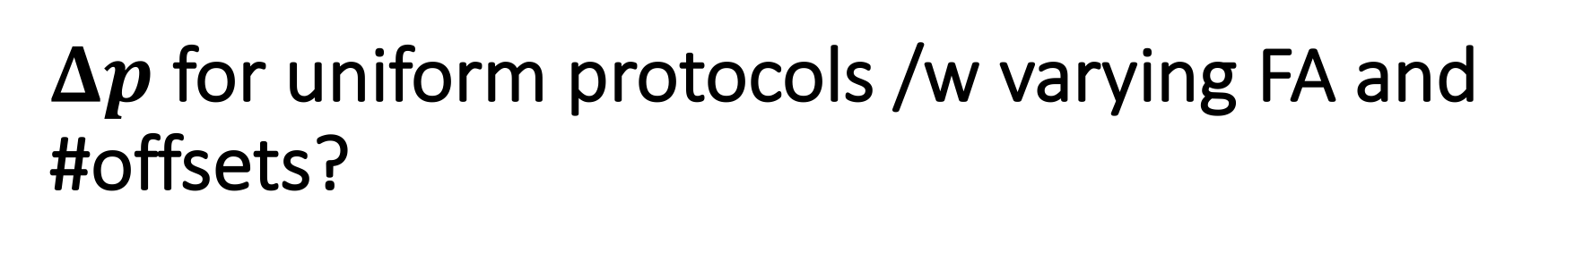
$Δp$ for uniform protocols /w varying FA and #offsets?

Slide 12
WM tissue parameter values
F = 0.15 n.u.
k_{f} = 4.0 s⁻¹
T_{1,f} = 900 ms
R_{1,r} = 1 s
T_{2,f} = 30 ms
T_{2,r} = 12 𝝁s

Slide 13
Protocol definitions
Single FA
150
400
650
2FA
(150, 400)
(150, 650)
(400, 650)
3FA
(150, 400, 650)
Offset values
[300 Hz, 20 kHz]
uniform-logarithmically spaced
Total # of points ranging from 8 to 30
Single FA, 8:2:30 offsets
2FA, 4:1:15 offsets
3FA, 3:1:10 FA

Slide 14
Protocol pre-procesing
Calculate higher « protocol resolution » Sf cache, then set-up each protocol using that Sf cache.
Some protocol points (<5%) produced erroneous/outlier (non-continuous) Jacobian element values
Form further testing, likely due to poor interpolation.
Identified all such point in the higher « protocol resolution » set, and if an outlier point was present in a studied protocol, change it to the nearest neighbour from high res.

Slide 15
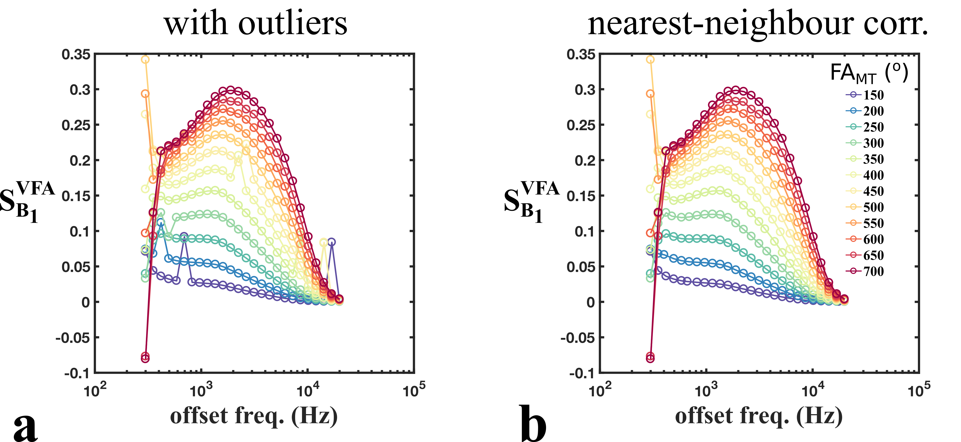

Slide 16
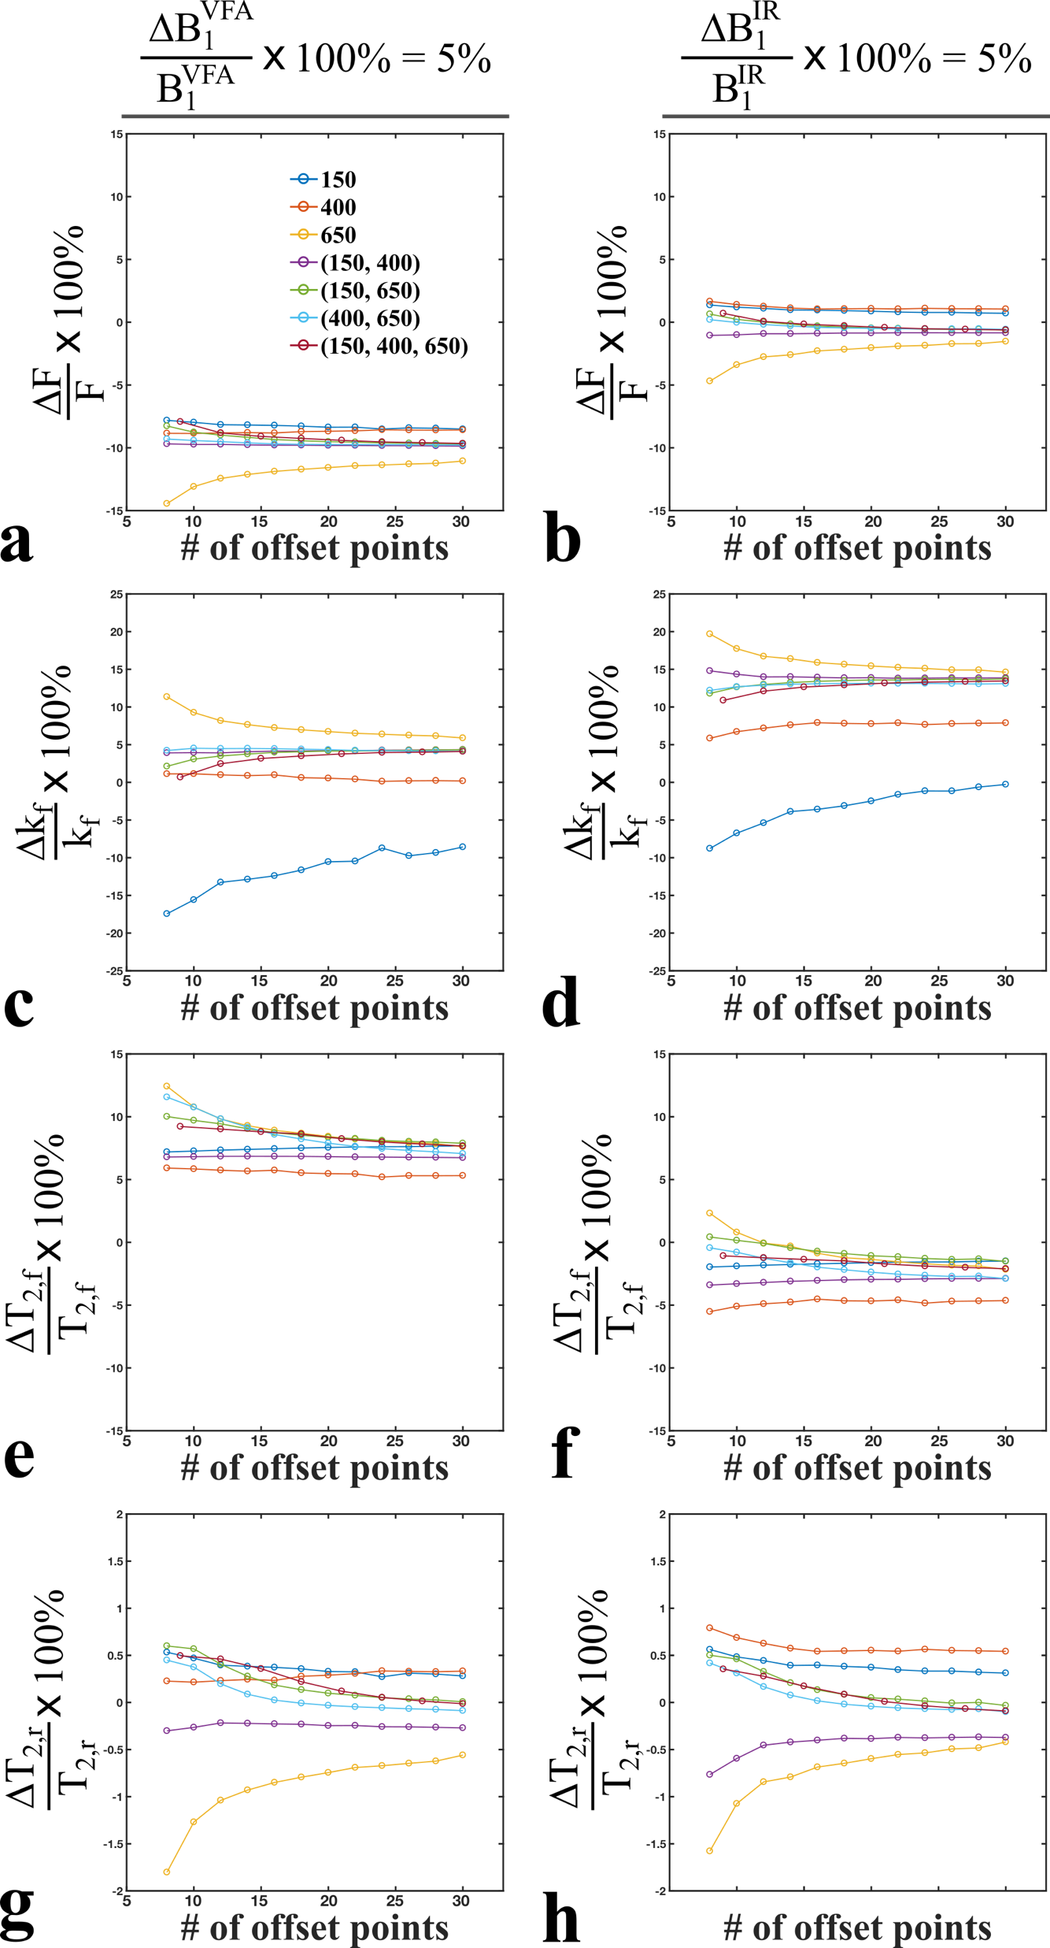

Slide 17
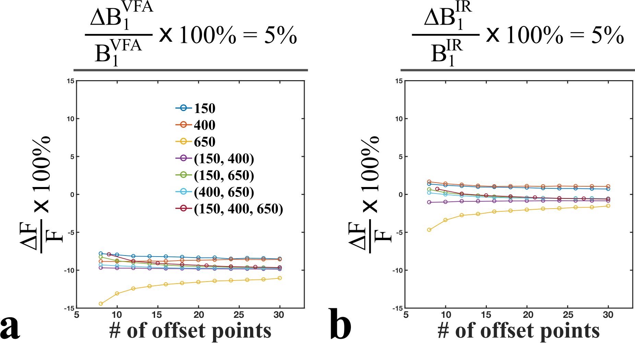

Slide 18
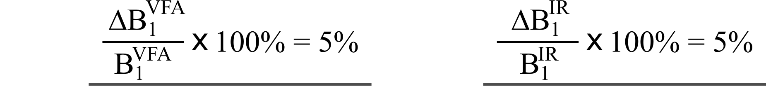
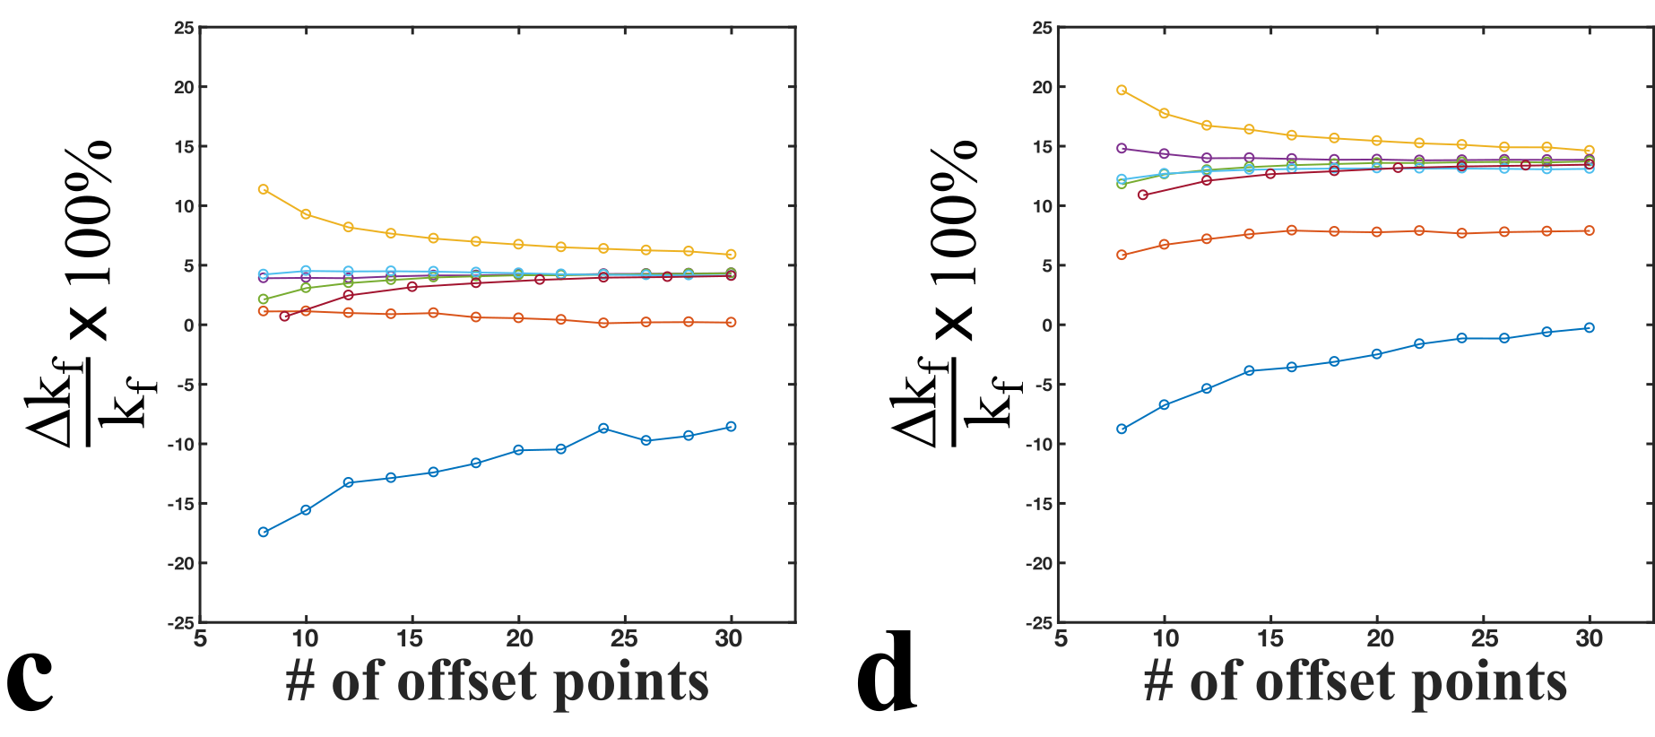
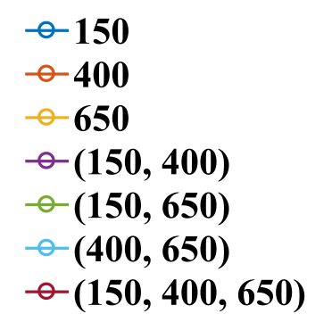

Slide 19
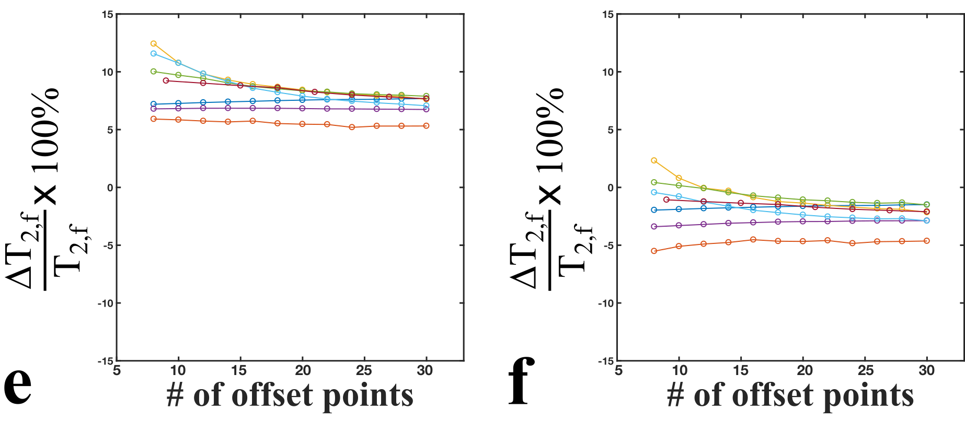

Slide 20
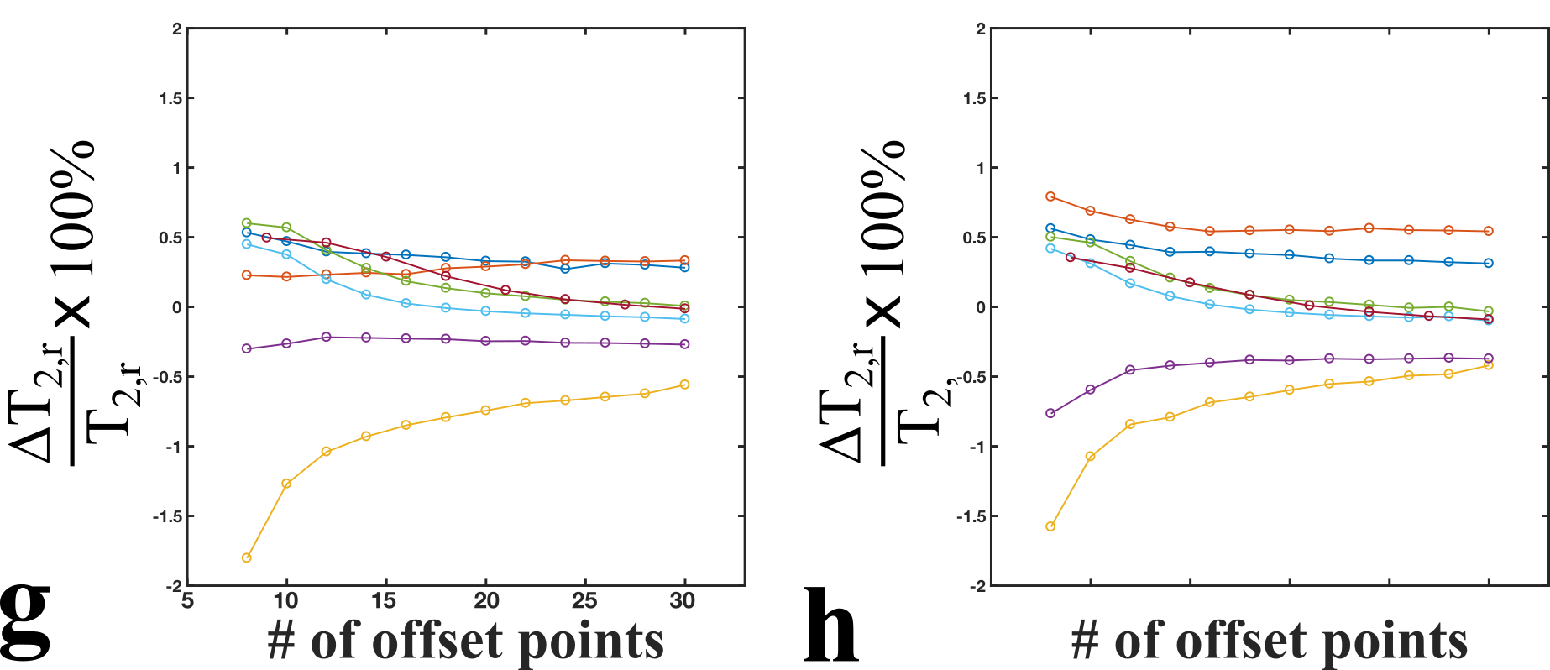

Slide 21
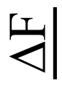
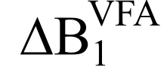
instead?

Slide 22
Jacobian/Sensitivity plots

Slide 23
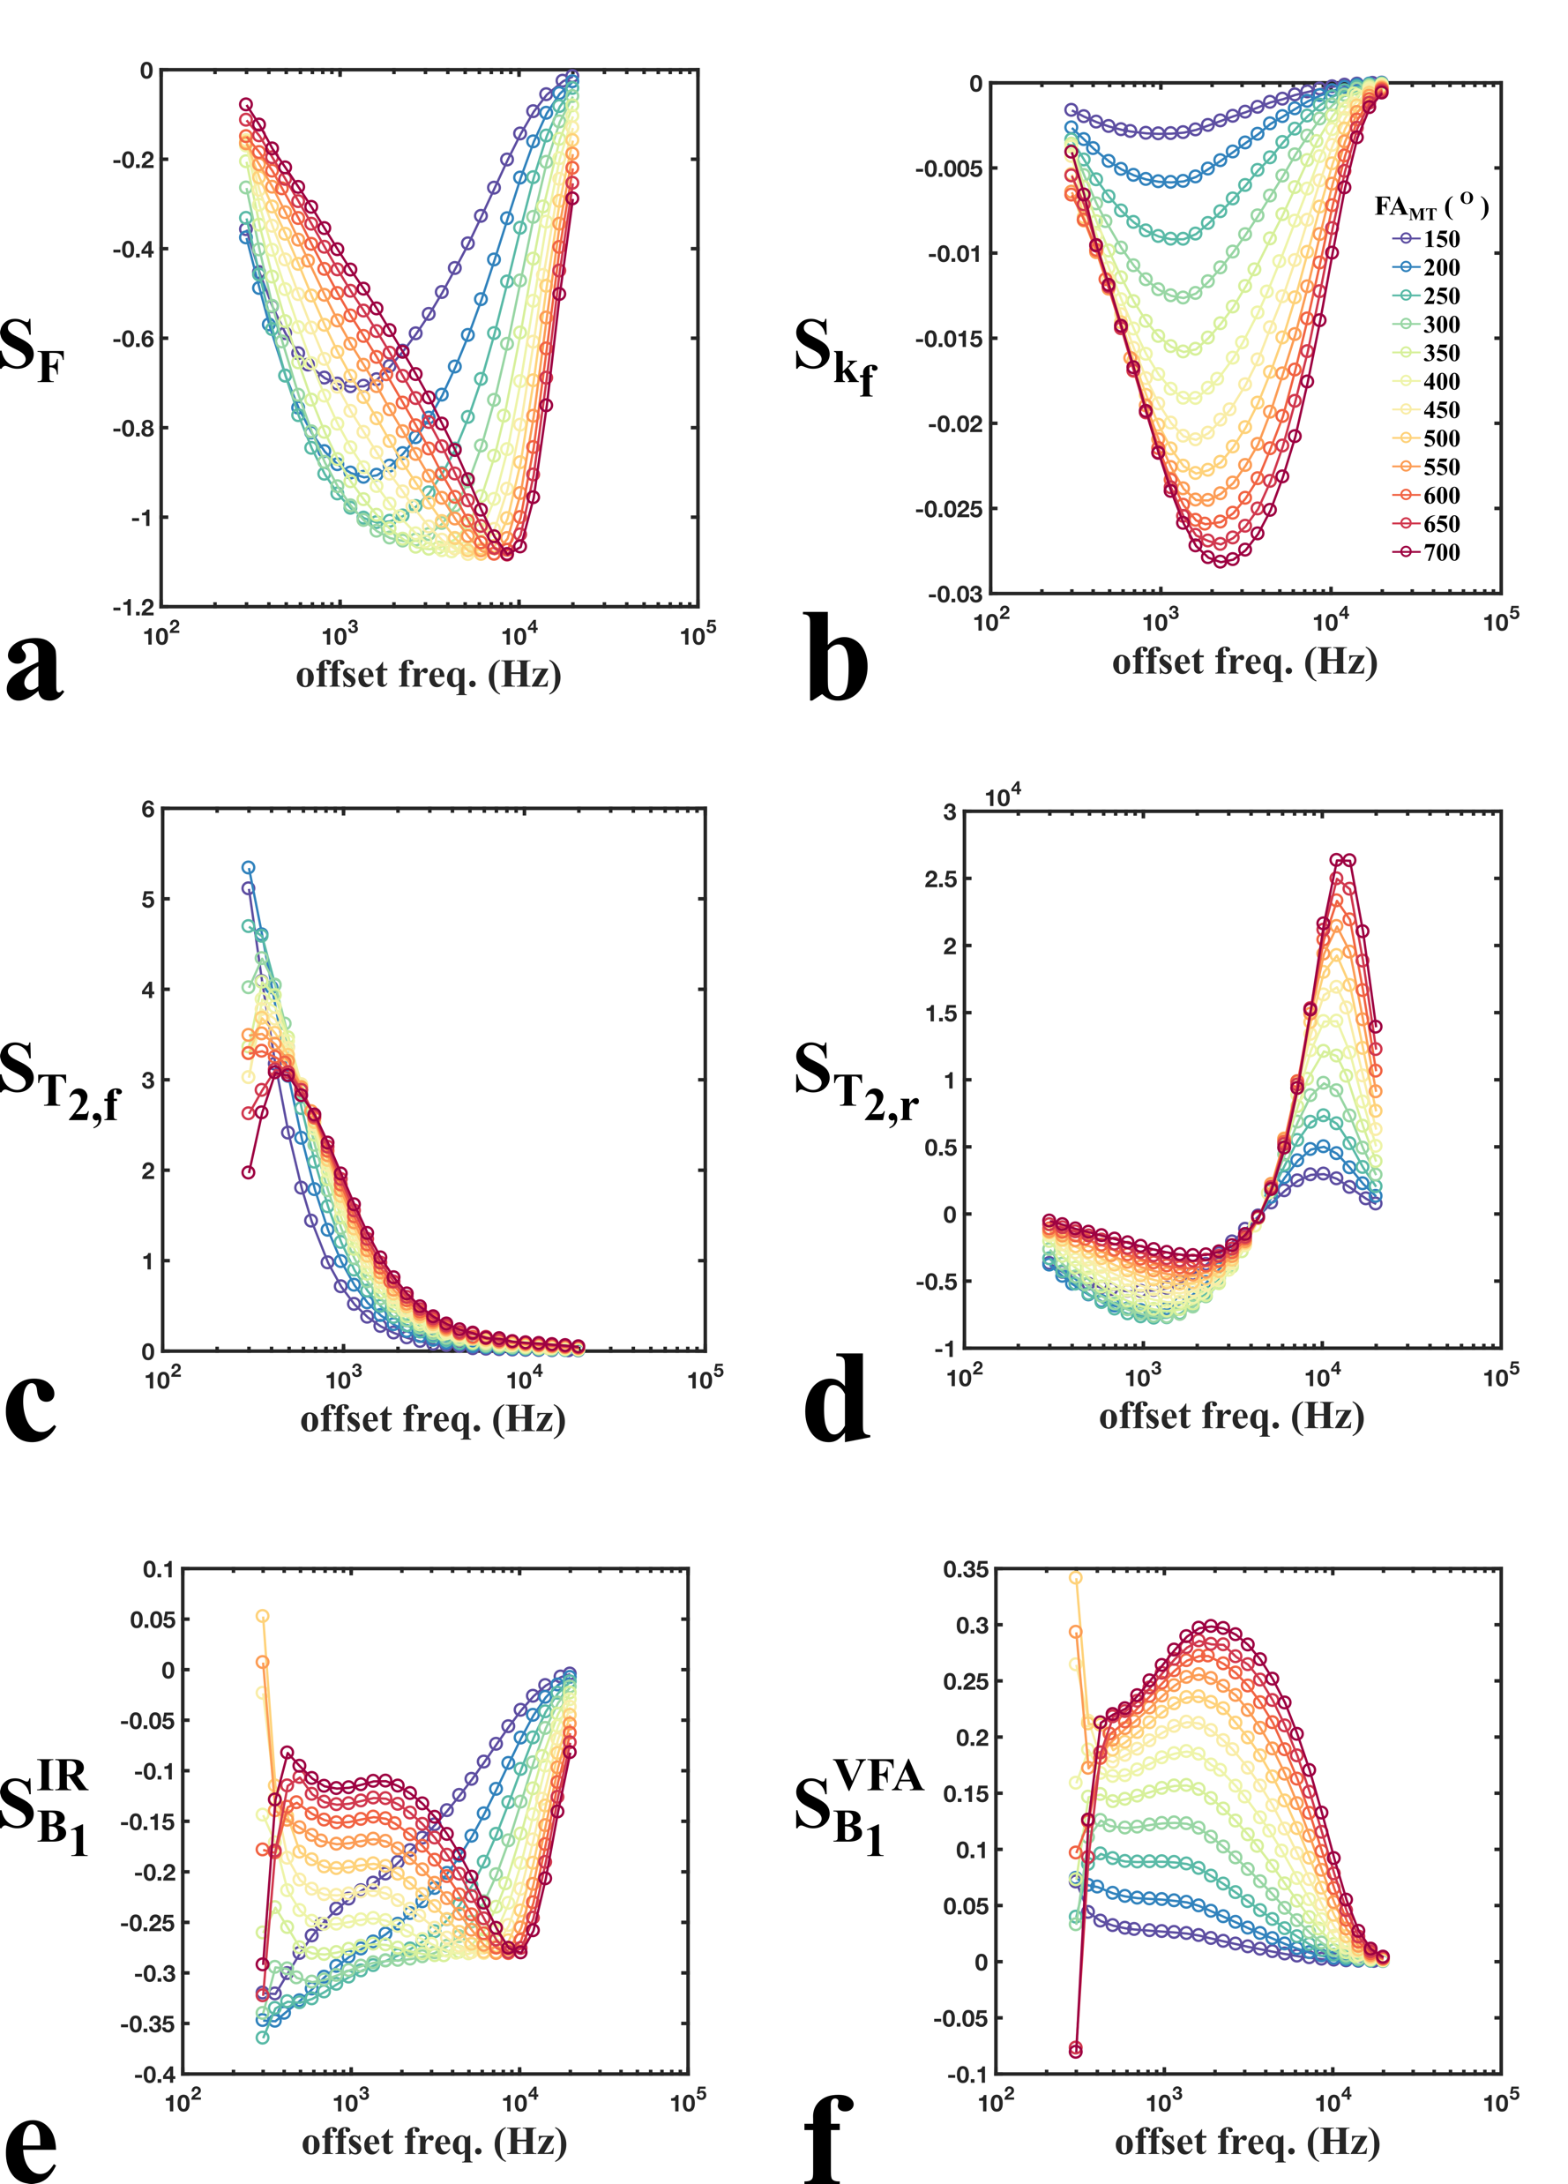

Slide 24
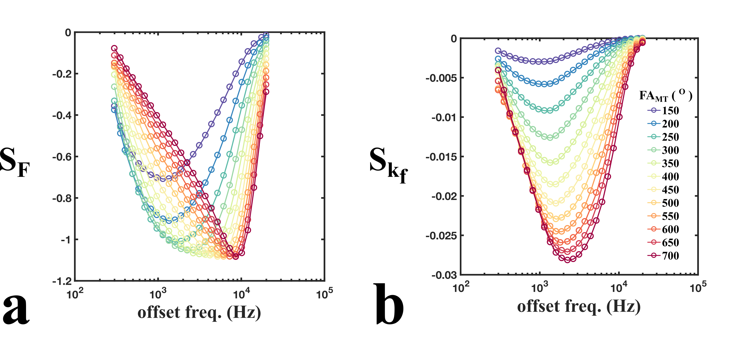

Slide 25
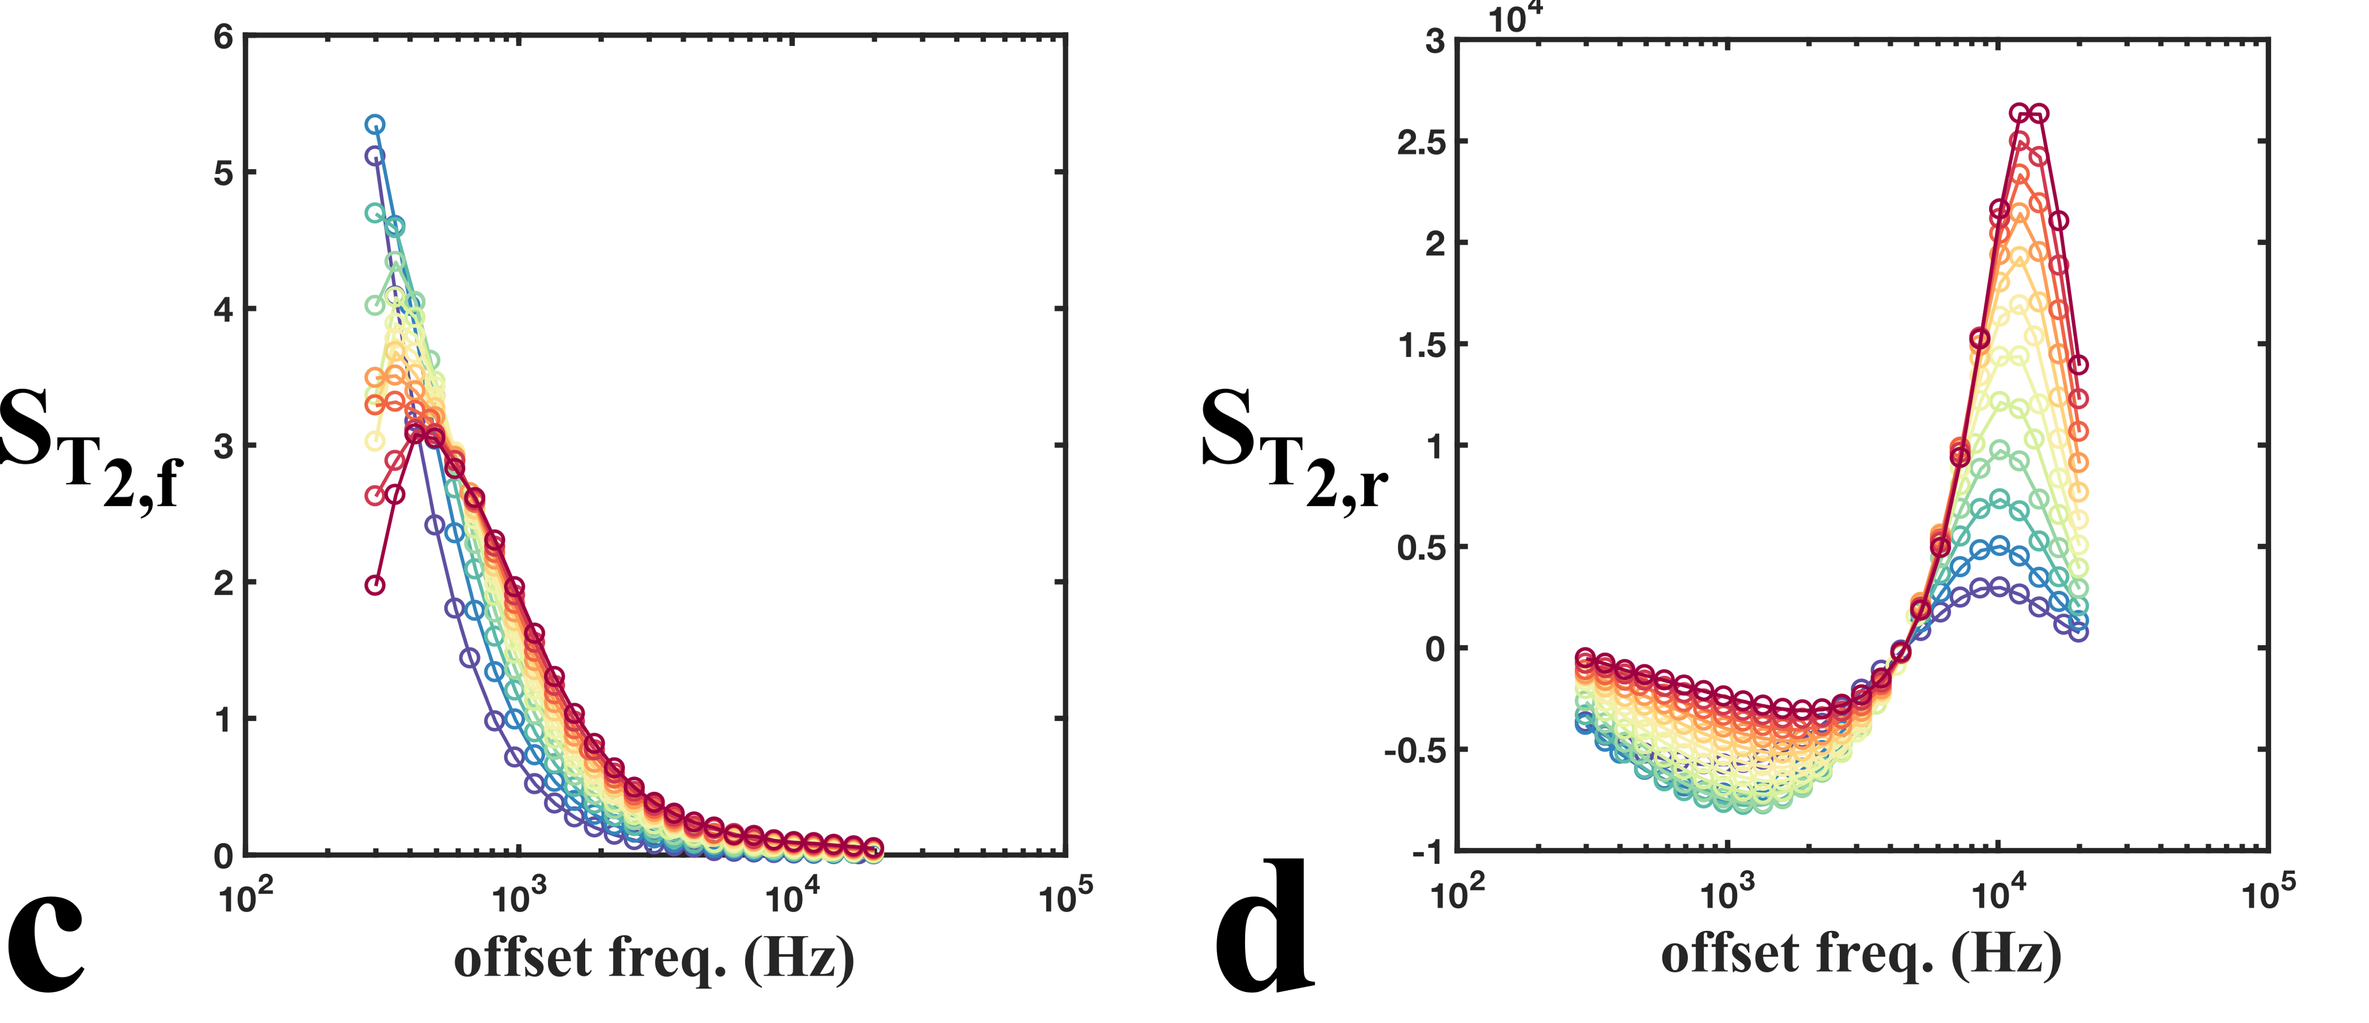
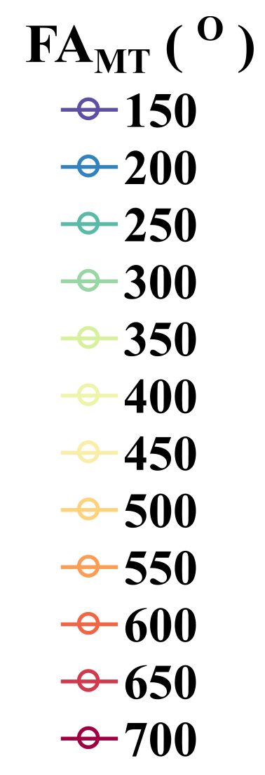

Slide 26
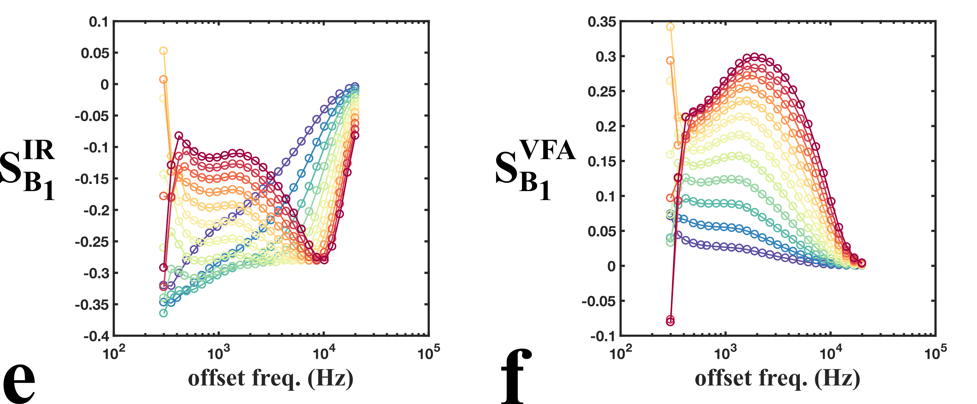

Slide 27
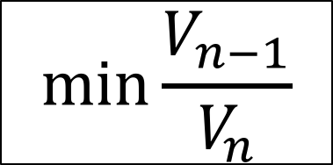
Iterative CRLB Optimization
Cercignani’s Fisher Information/Cramer-Rao Lower Bound equations
$$\min{\frac{V_{n−1}}{V_{n}}}$$
, considering all n-1 protocol combinations

Slide 28
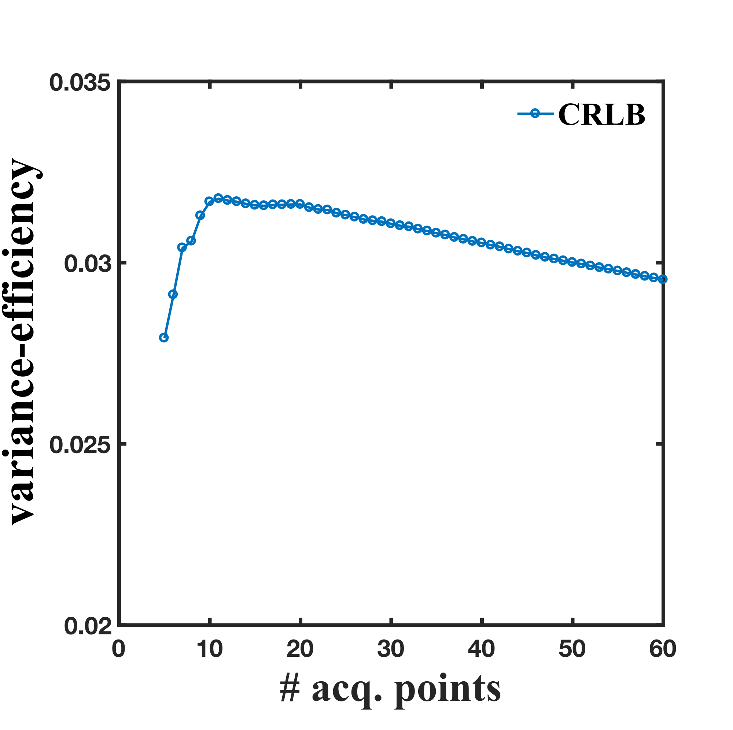
Iterative CRLB Optimization; comparison with Ives

Slide 29
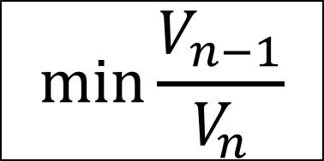
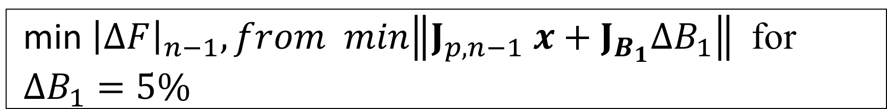
Single Optimization
$$\min{\frac{V_{n−1}}{V_{n}}}$$
vs
min ${\left|ΔF\right|}_{n−1}, from min\left\|J_{p,n−1} x+J_{B_{1}}ΔB_{1}\right\|$ for $ΔB_{1}=5\%$

Slide 30
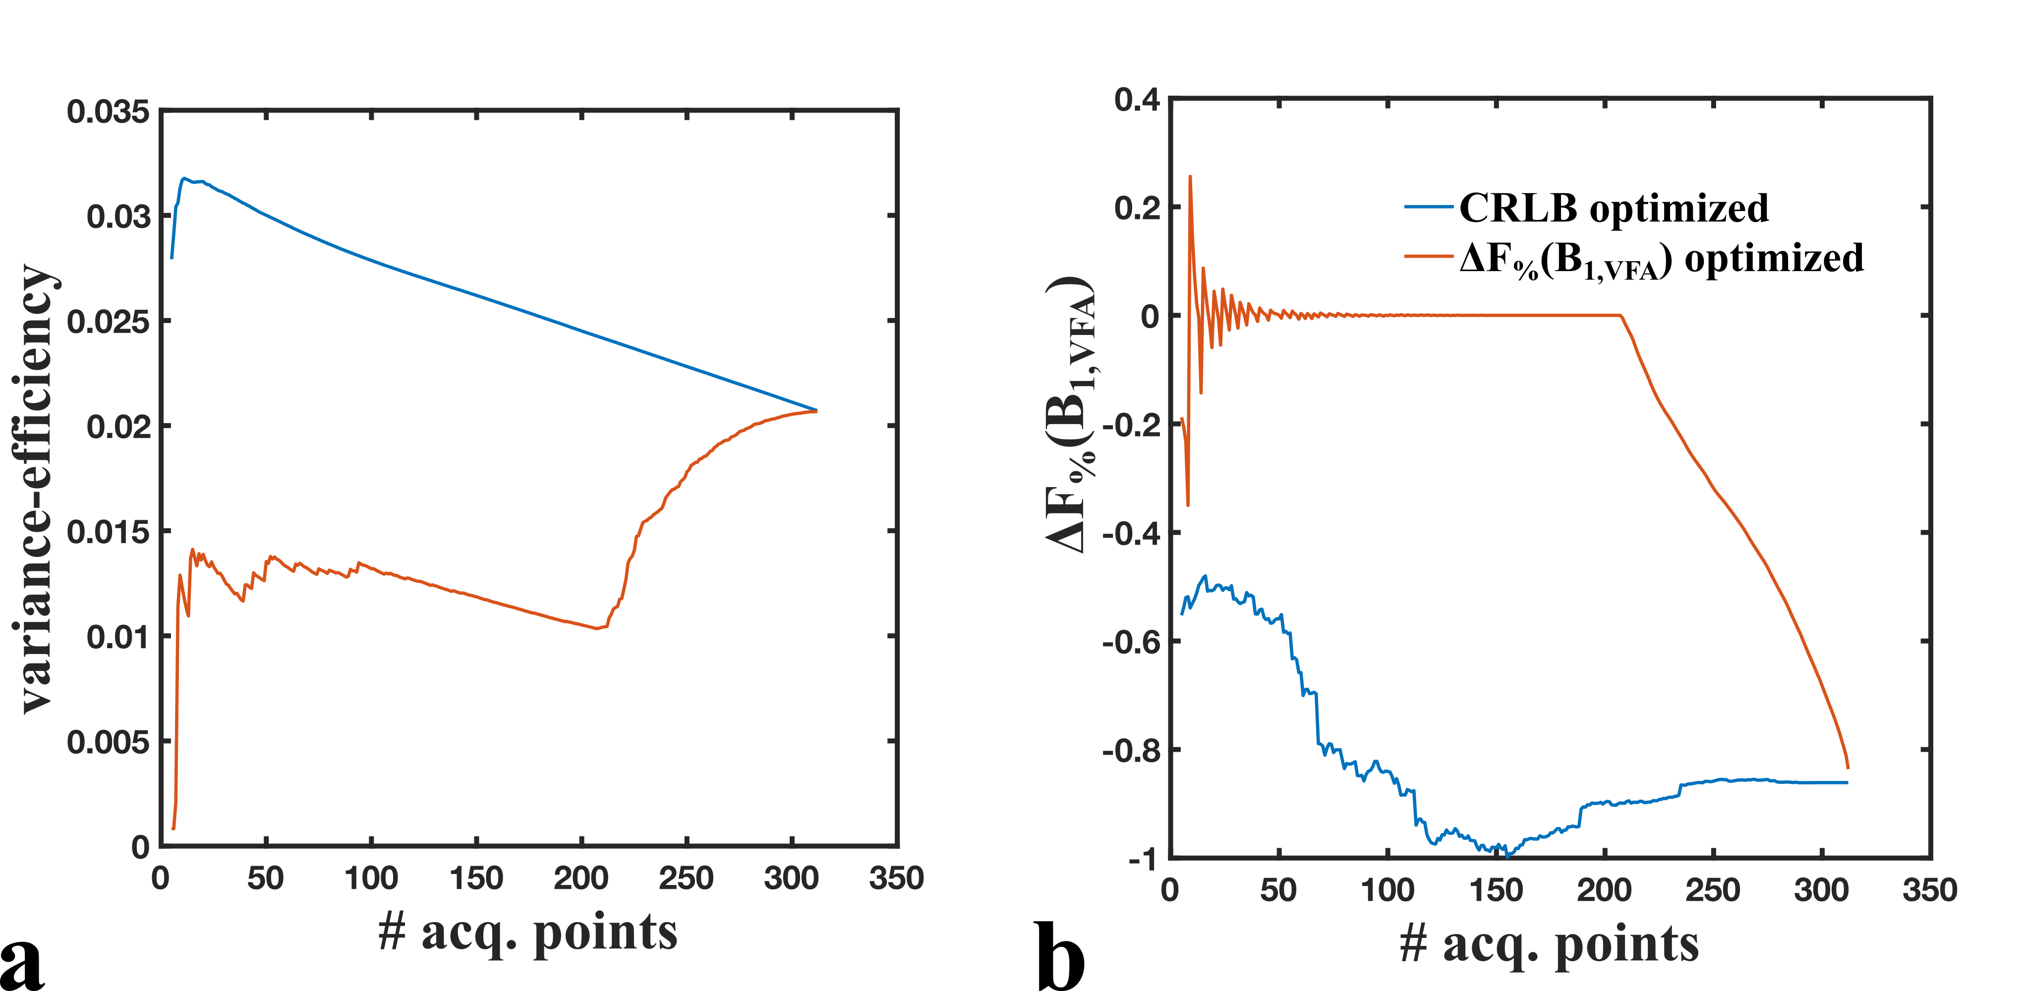
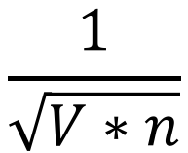
$$\frac{1}{\sqrt{V∗n}}$$
* variance-efficiency =

Slide 31
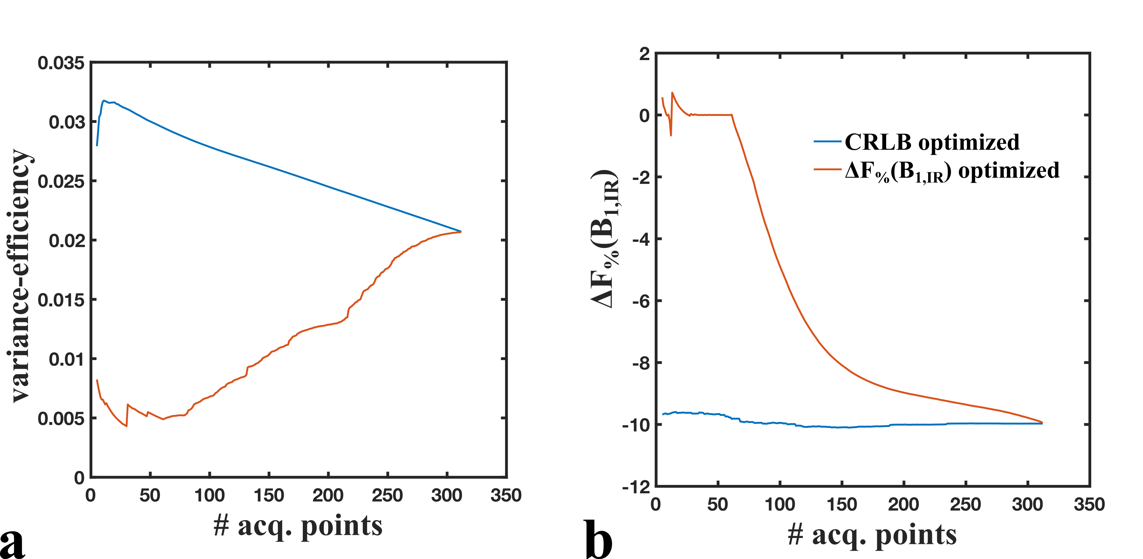

Slide 32
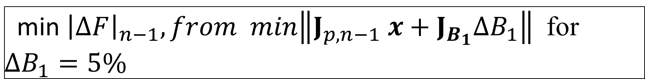
Single Optimization
$$\min{\frac{V_{n−1}}{V_{n}}}$$
vs
min ${\left|ΔF\right|}_{n−1}, from min\left\|J_{p,n−1} x+J_{B_{1}}ΔB_{1}\right\|$ for $ΔB_{1}=5\%$

Slide 33
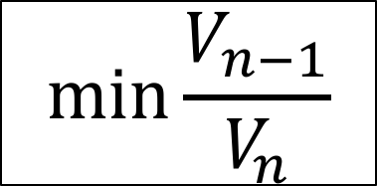
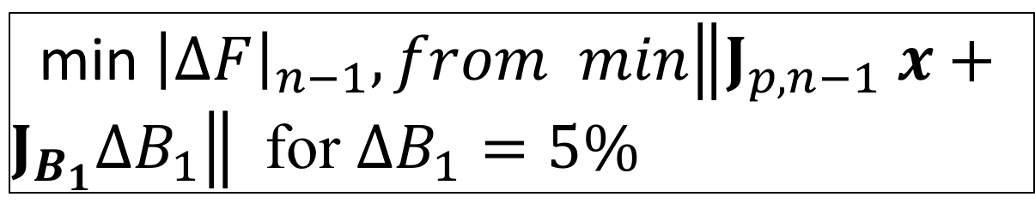
Alternating Optimization
$$\min{\frac{V_{n−1}}{V_{n}}}$$
odd n-1
min ${\left|ΔF\right|}_{n−1}, from min\left\|J_{p,n−1} x+J_{B_{1}}ΔB_{1}\right\|$ for $ΔB_{1}=5\%$
even n-1

Slide 34
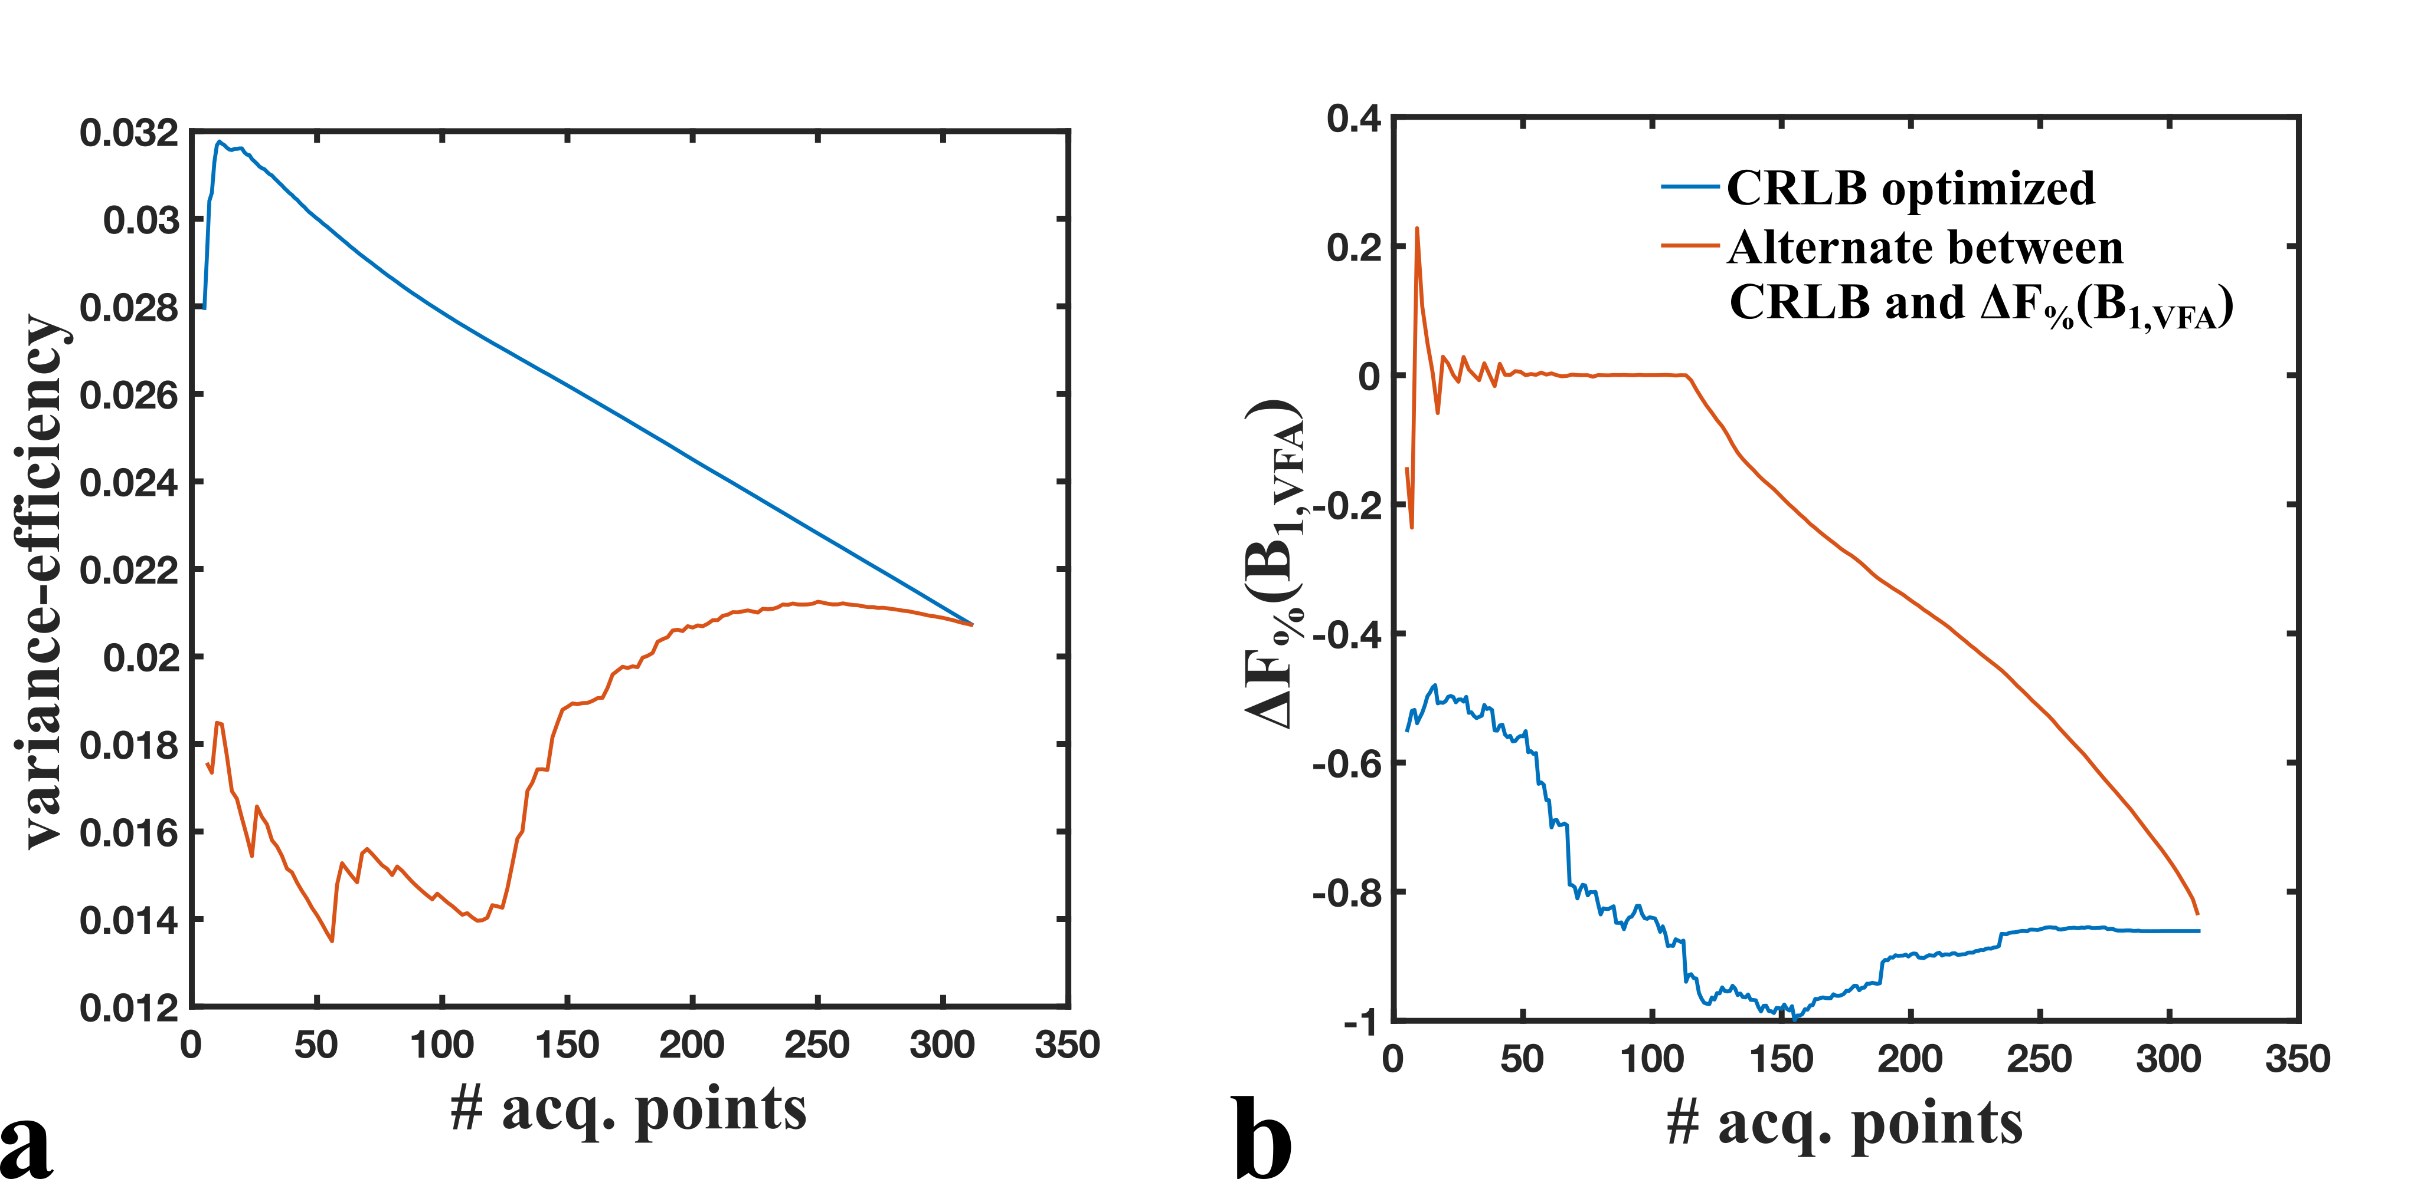

Slide 35
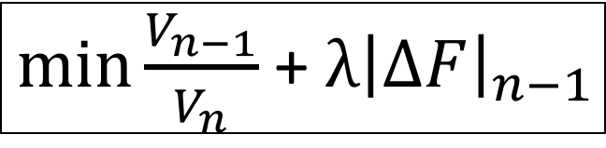
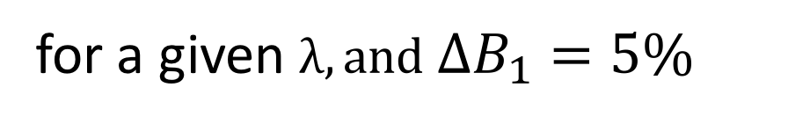
Regularized Optimization
$\min{\frac{V_{n−1}}{V_{n}}}$ + $λ{\left|ΔF\right|}_{n−1}$
for a given $λ,and ΔB_{1}=5\%$

Slide 36
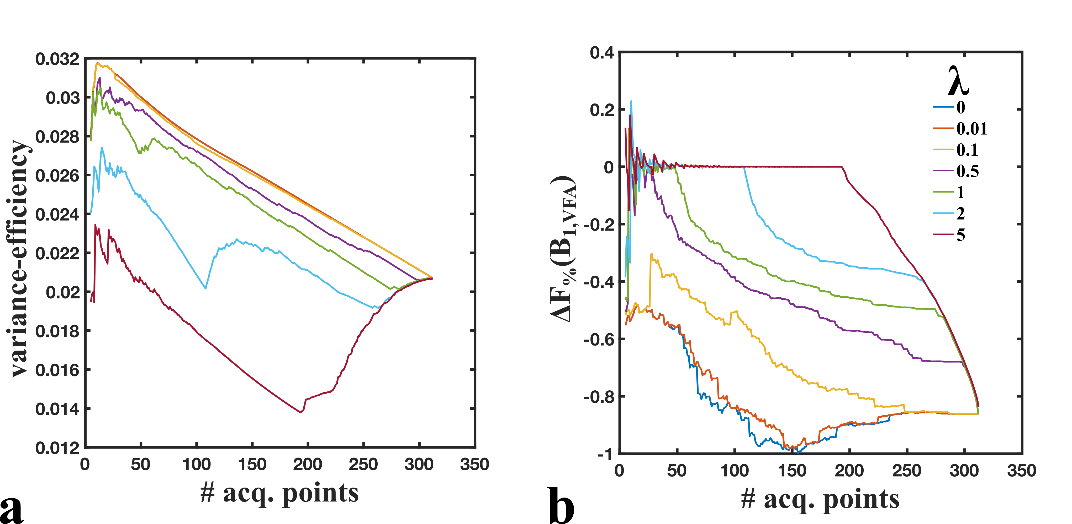

Slide 37
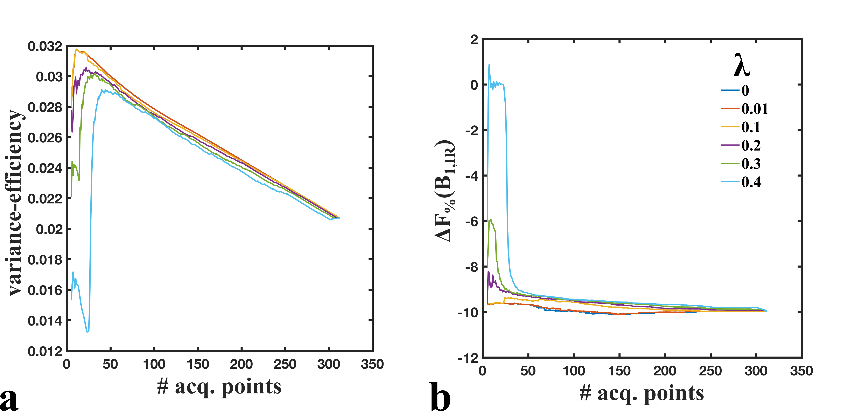

Slide 38
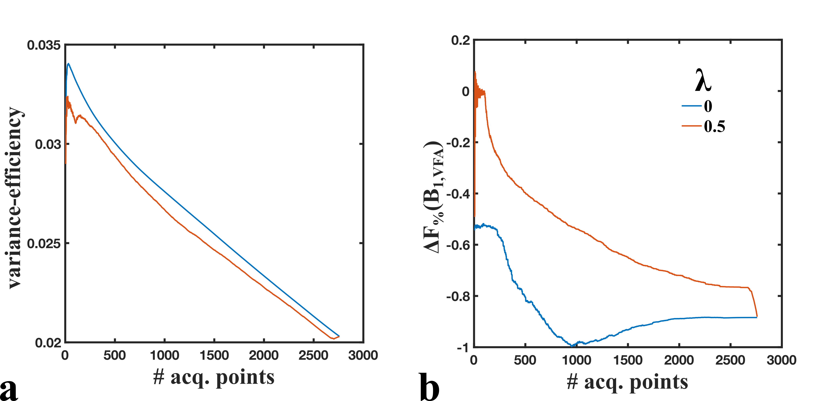

Slide 39
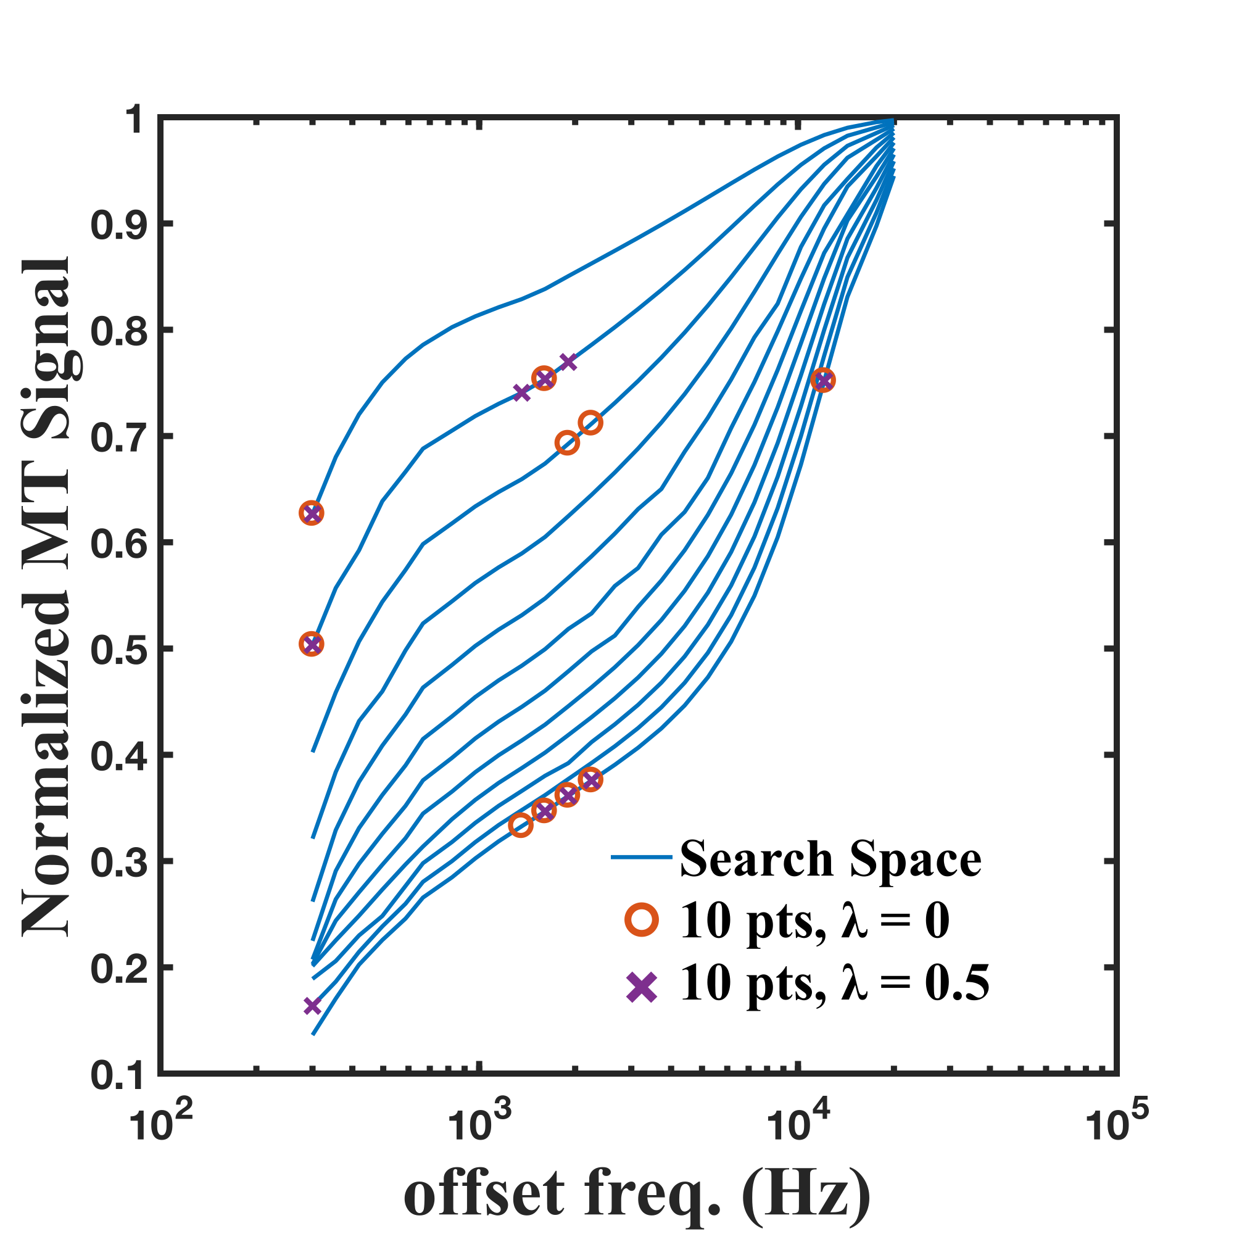

Slide 41
To-Do

